Slide 1
Businesses and the Costs of Production
From:
Book 1: Chapter 9

Slide 2
Economic Costs
The payment that must be made to obtain and retain the services of a resource
Economic costs = Explicit costs + Implicit costs
Explicit Costs
Monetary payments
Implicit Costs
Value of next best use
Self-owned resources
LO1

Slide 3
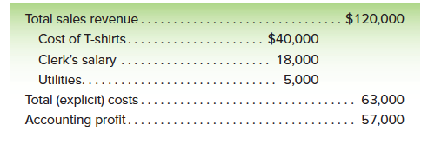
Accounting Profit and Economic Profit
Suppose that after many years working as a sales representative for a large T-shirt manufacturer, you decide to strike out on your own. After considering many potential business ventures, you settle on opening a retail T-shirt shop.
LO1

Slide 4
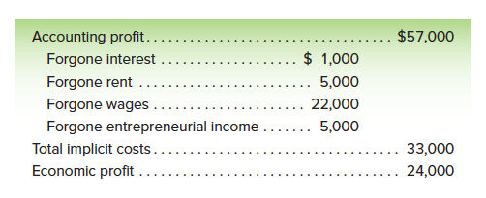
Accounting Profit and Economic Profit
LO1

Slide 5
Accounting Profit and Economic Profit
Accounting profit
= Revenue – Explicit Costs
Economic profit
= Accounting Profit – Implicit Costs
Economic profit (to summarize)
=Total Revenue – Economic Costs
=Total Revenue – Explicit Costs – Implicit Costs
LO1

Slide 6
Economic Profit
Economic
profit
Accounting profit
Implicit costs (including a normal profit)
Total Revenue
Accounting costs (explicit costs only)
Economic
(Opportunity)
Costs
Explicit
costs
LO1

Slide 7
Short Run and Long Run
Short Run
Some variable inputs
Fixed plant
Long Run
All inputs are variable
Variable plant
Firms enter and exit
LO1

Slide 8
Short-Run Production Relationships
Total Product (TP)
Marginal Product (MP)
Average Product (AP)
Change in Total Product
Marginal Product
=
Change in Labor Input
Average Product
=
Total Product
Units of Labor
LO2

Slide 9
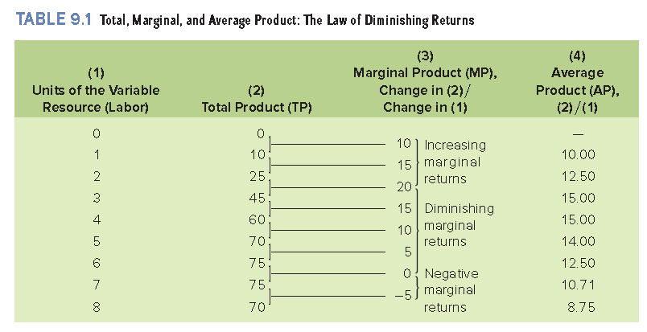
The Law of Diminishing Returns
LO2

Slide 10
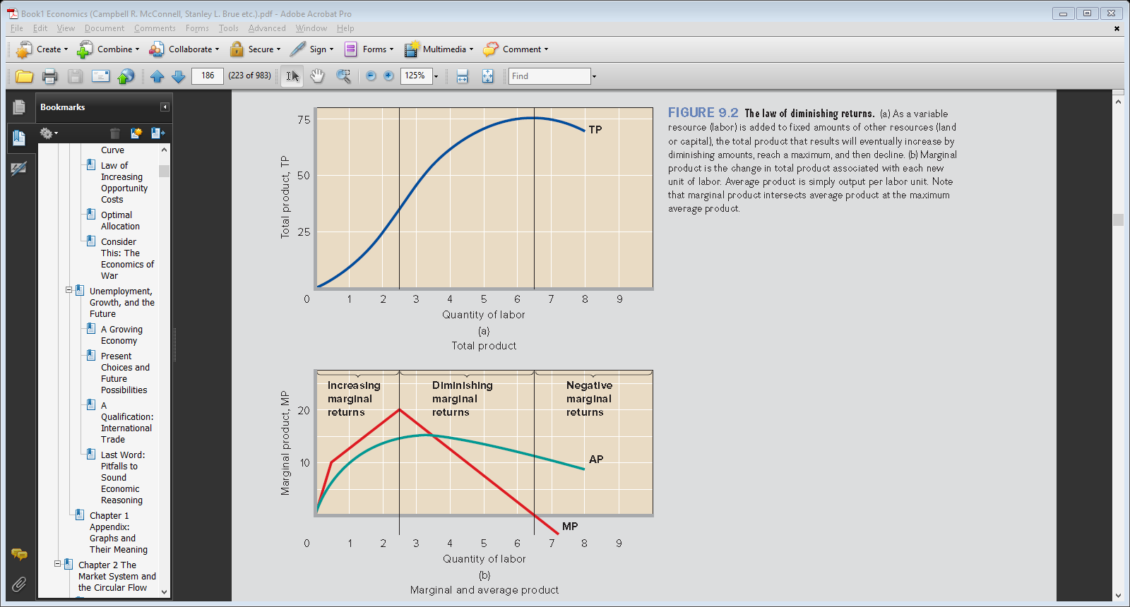
The Law of Diminishing Returns
LO2

Slide 11
Short-Run Production Costs
Fixed, Variable, and Total Costs
Fixed Costs (TFC)
Costs do not vary with output
Variable Costs (TVC)
Costs vary with output
Total Costs (TC)
Sum of TFC and TVC
TC = TFC + TVC
LO3

Slide 12
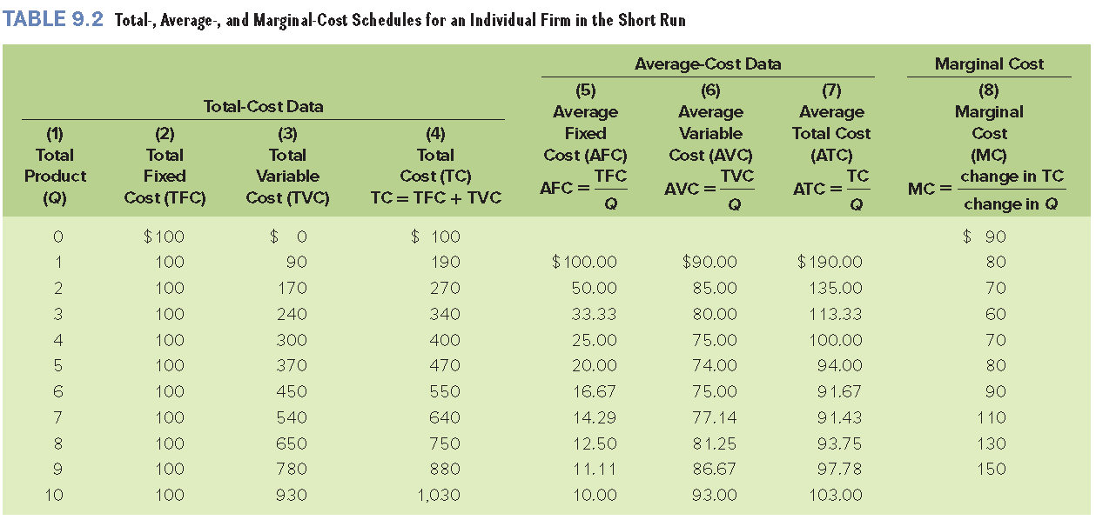
Short-Run Production Costs
LO3

Slide 13
Short-Run Production Costs
$1100
1000
TC
900
TVC
800
700
600
Costs
Fixed
Cost
500
400
300
Total
Cost
Variable
Cost
200
100
TFC
0
1
2
3
4
5
6
7
8
9
10
Q
LO3

Slide 14
Per-Unit, or Average, Costs
Average Fixed Costs
AFC = TFC/Q
Average Variable Costs
AVC = TVC/Q
Average Total Costs
ATC = TC/Q = (TFC/Q) + (TVC/Q) = AFC + AVC
Marginal Costs
MC = ΔTC/ΔQ
LO3

Slide 15
Per-Unit, or Average, Costs
$200
150
ATC
Costs
100
AVC
AFC
50
AVC
AFC
0
1
2
3
4
5
6
7
8
9
10
Q
LO3

Slide 16
Marginal Cost
$200
MC
150
ATC
Costs
100
AVC
AFC
50
AVC
AFC
0
1
2
3
4
5
6
7
8
9
10
Q
LO3

Slide 17

MC and Marginal Product
Production Curves
Average Product and
Marginal Product
AP
MP
Quantity of Labor
MC
AVC
Cost (Dollars)
Cost Curves
Quantity of Output
LO3

Slide 18
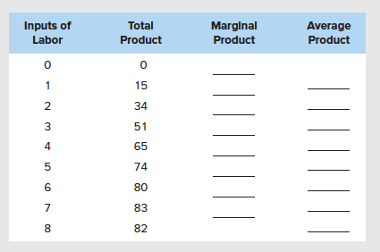
Complete the following table

Slide 19
Continue with last slide
Plot the total, marginal, and average products and explain in detail the relationship between each pair of curves.
Explain why marginal product first rises, then declines, and ultimately becomes negative.
What bearing does the law of diminishing returns have on short-run costs?
Illustrate and explain graphically.

Slide 20
Long-Run Production Costs
The firm can change all input amounts, including plant size.
All costs are variable in the long run.
Long run ATC
Different short run ATCs
Long-run cost curve also known as Planning Curve.
LO4

Slide 21
The Long-Run Cost Curve
ATC-1
ATC-5
ATC-2
Average Total Costs
ATC-3
ATC-4
Long-Run
ATC
Output
LO4

Slide 22
Economies and Diseconomies of Scale
Economies of scale
Labor specialization
Managerial specialization
Efficient capital
Other factors
Constant returns to scale
LO4

Slide 23
Economies and Diseconomies of Scale
Diseconomies of scale
Control and coordination problems
Communication problems
Worker alienation
Shirking
LO4

Slide 24
MES and Industry Structure
Minimum Efficient Scale (MES):
Lowest level of output where long- run average costs are minimized
Can determine the structure of the industry
LO4

Slide 25
MES and Industry Structure
Economies
Of Scale
Constant Returns
To Scale
Diseconomies
Of Scale
Average Total Costs
Long-Run
ATC
q₁
q₂
Output
LO4

Slide 26
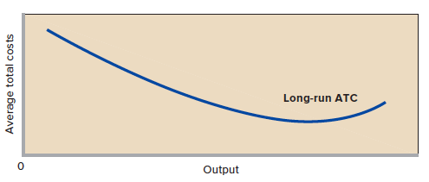
MES and Industry Structure
LO4

Slide 27
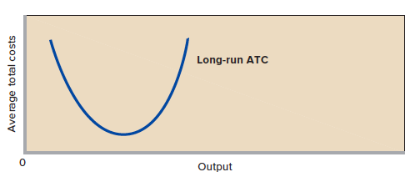
MES and Industry Structure
LO4

Slide 28
Reading Assignment
3-D Printers
3-D Printers Are Poised to Replace Mass Production with Mass Customization.
Book 1, Page 196

